Slide 1
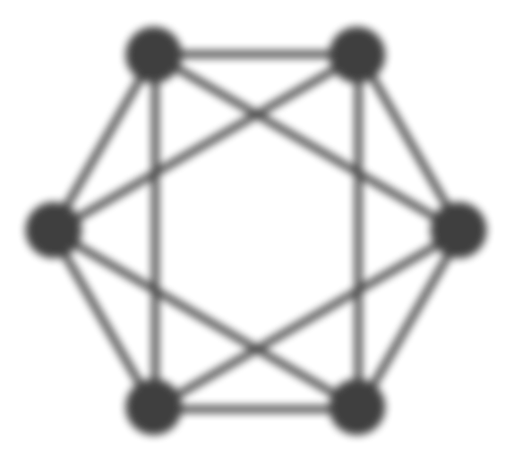
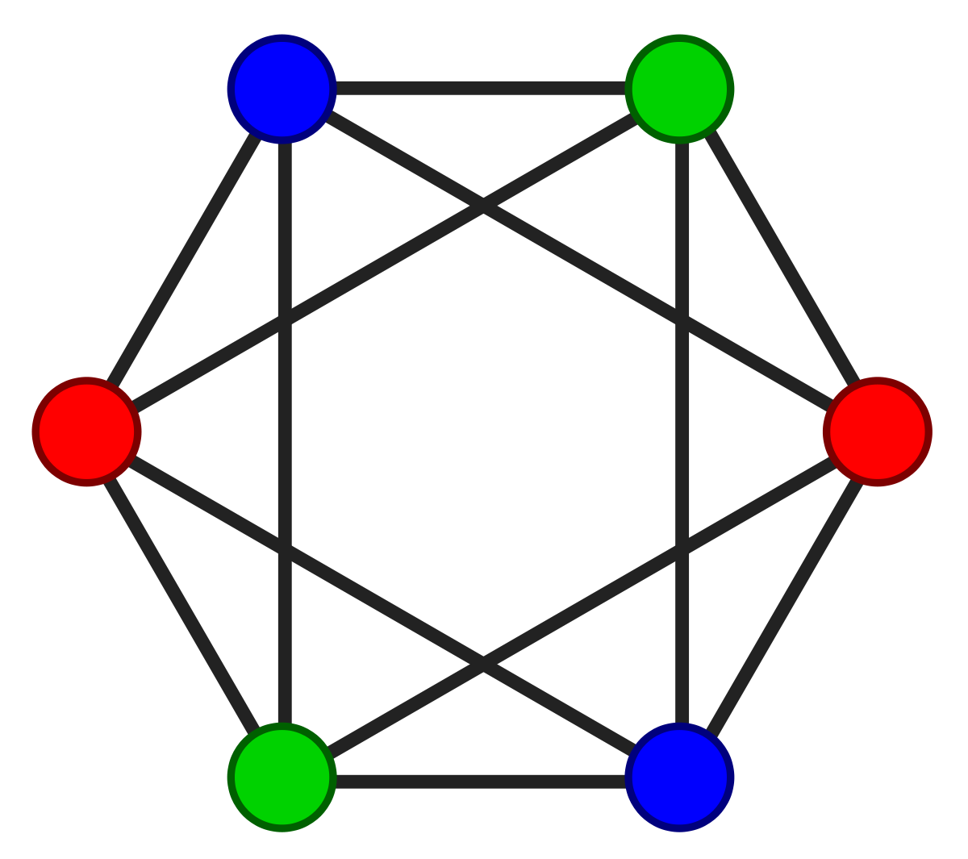
GRAPH COLOURING PROBLEM
LOGIC OF INFERENCE
Asad Ullah Khan Agha Fardeen | K214945 K213371

Slide 2
PROBLEM STATEMENT
The general graph colouring problem deals with colouring edges or vertices of a graph subject to various constraints. The most vanilla flavoured version of the graph colouring problem is vertex colouring problem which states that : given a set of n colours, we
need to colour each vertex such that all adjacent vertices have distinct colours.
Formally, a vertex colouring is an assignment of labels or colours to each vertex of a
graph such that no edge connects two identically coloured vertices. The most common type of vertex colouring seeks to minimize the number of colours for a given graph.
Such a colouring is known as minimum vertex colouring, and the minimum number of colours which with the vertices of a graph may be coloured is called the chromatic
number, denoted by x(G).

Slide 3
PROBLEM TYPES
The problem has two types of questions:
M - colourability decision : In this type of question we are provided with the
chromatic number and we need to check whether the graph can be coloured with the given number of colours or not.
●
M - colourability optimization : In this type of question we are supposed to find the chromatic number of the given graph

Slide 4
ALGORITHMS
Greedy Graph Colouring Algorithm (Vanilla)
Greedy Graph Colouring By Ordering Nodes By Largest Degree First
Greedy Graph Colouring By Random Ordering of Nodes
Greedy Graph Colouring Using BFS/DFS
Welsh Powell Algorithm For Both Connected and Disconnected graphs

Slide 5
METHODOLOGY

Slide 6
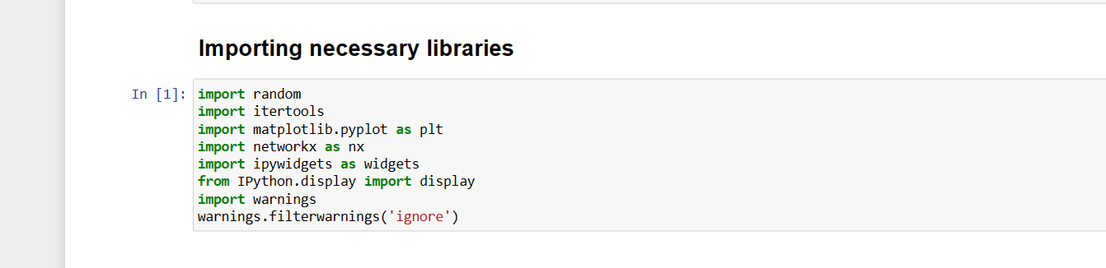
IMPORTANT LIBRARIES

Slide 7
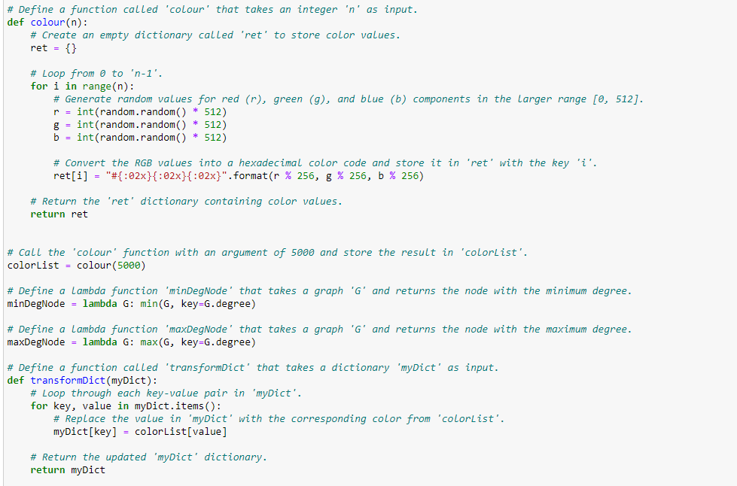
HELPER FUNCTIONS

Slide 8
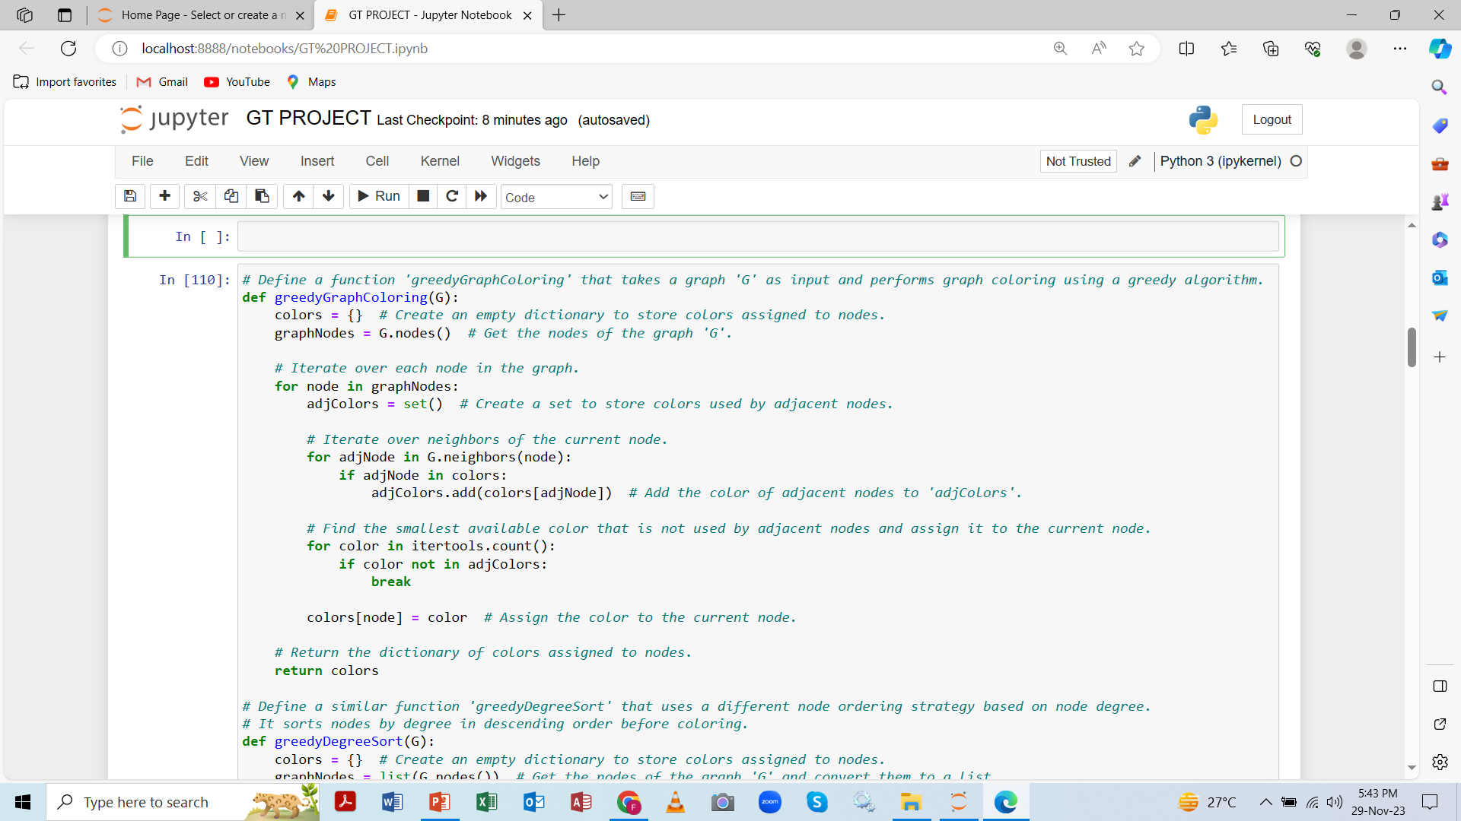
GREEDY GRAPH COLOURING ALGORITHM (VANILLA)

Slide 9
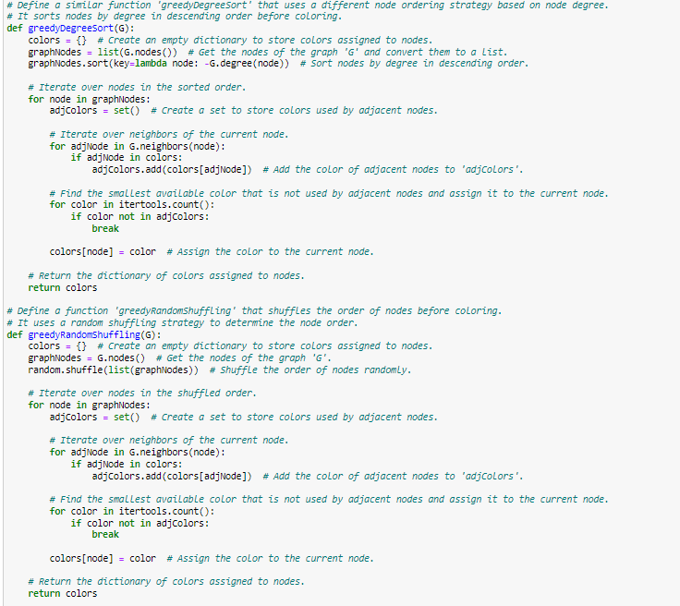
GREEDY GRAPH COLOURING ALGORITHM USING PRE-PROCESSING

Slide 10
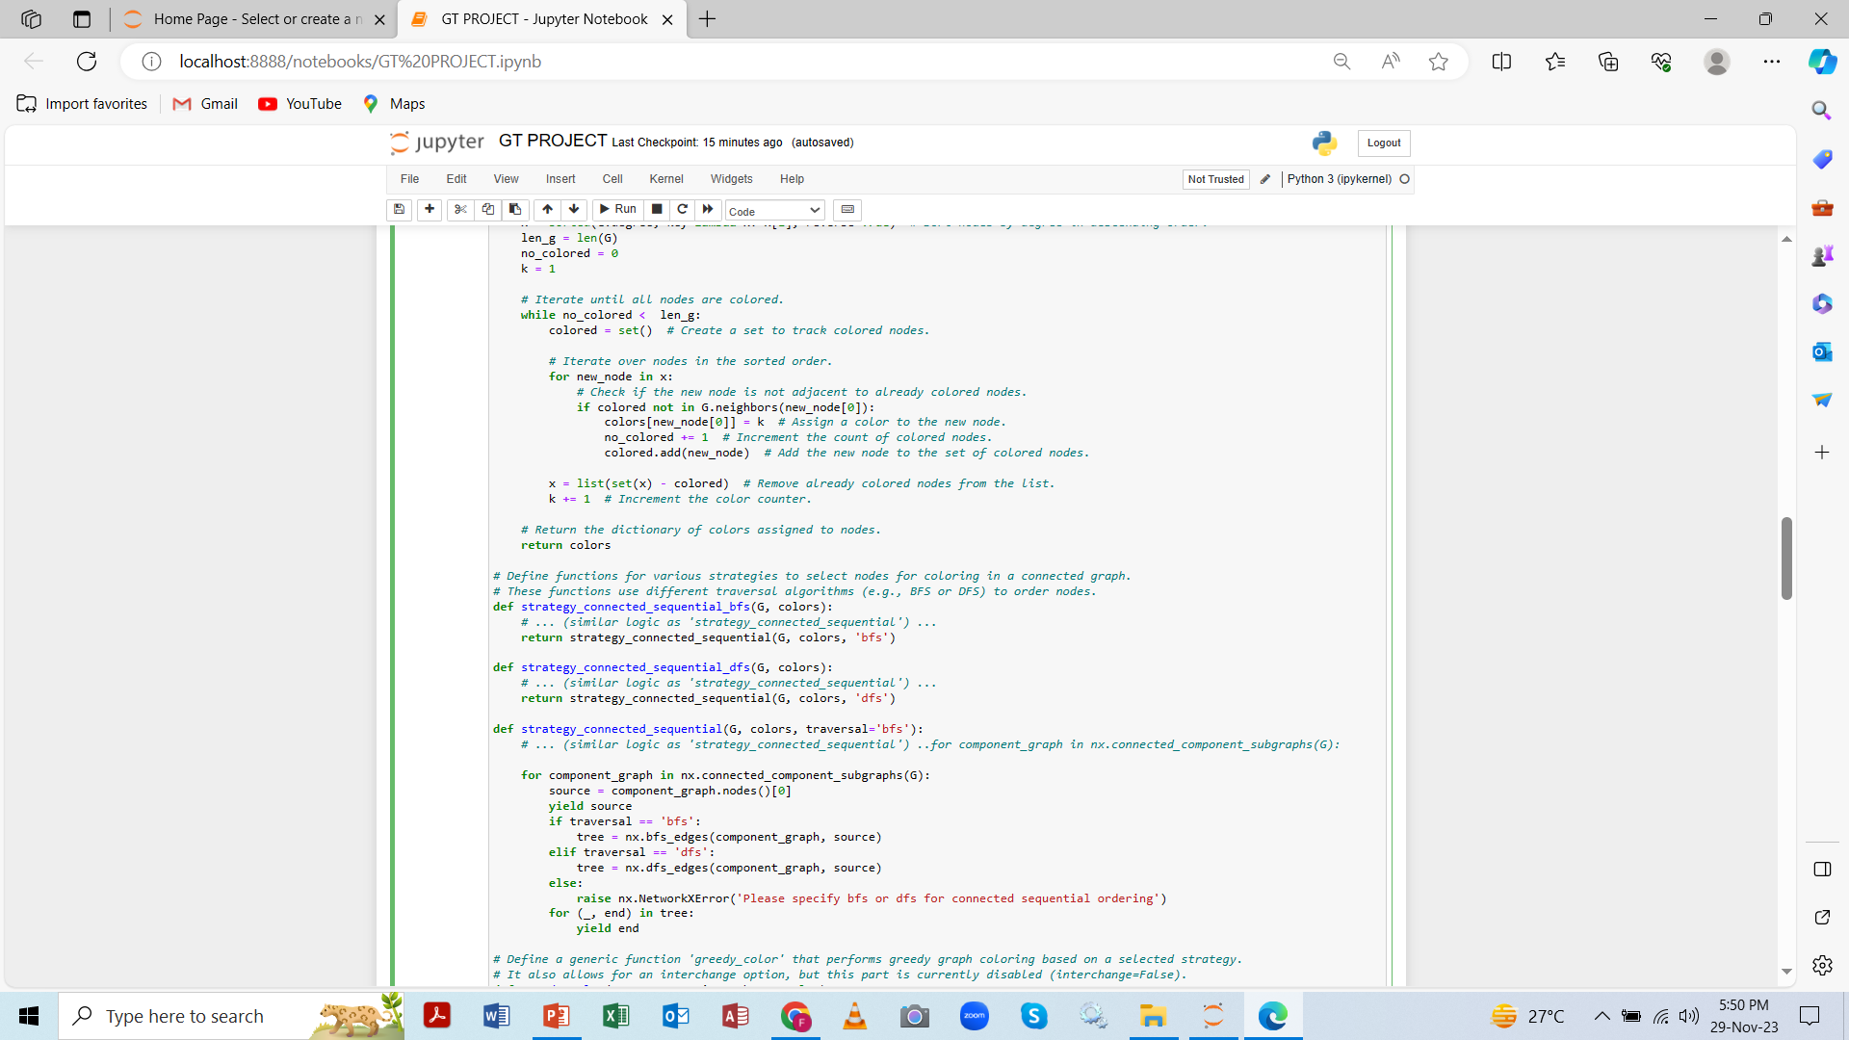
GREEDY GRAPH COLOURING ALGORITHM USING DFS/BFS

Slide 11
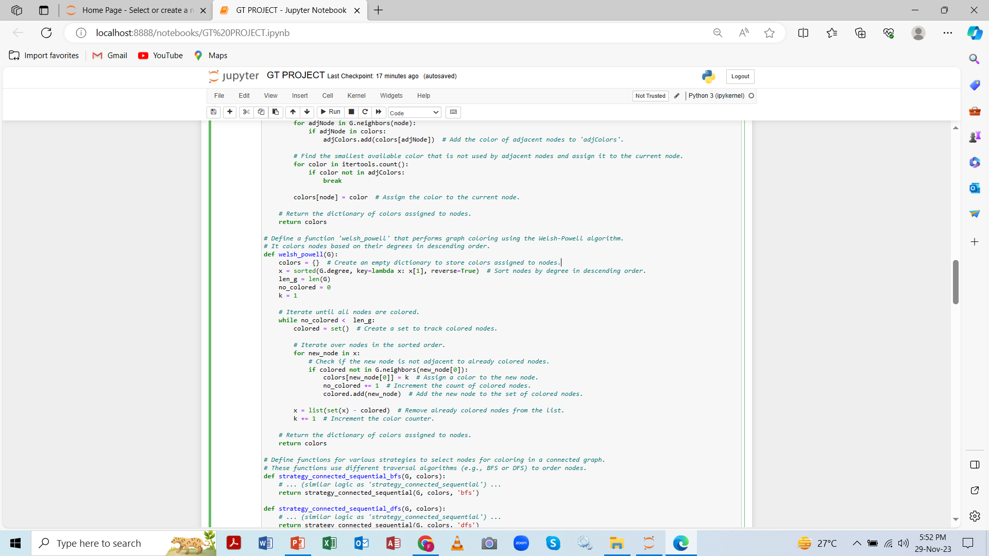
WELSH POWELL ALGORITHM FOR CONNECTED GRAPHS

Slide 12
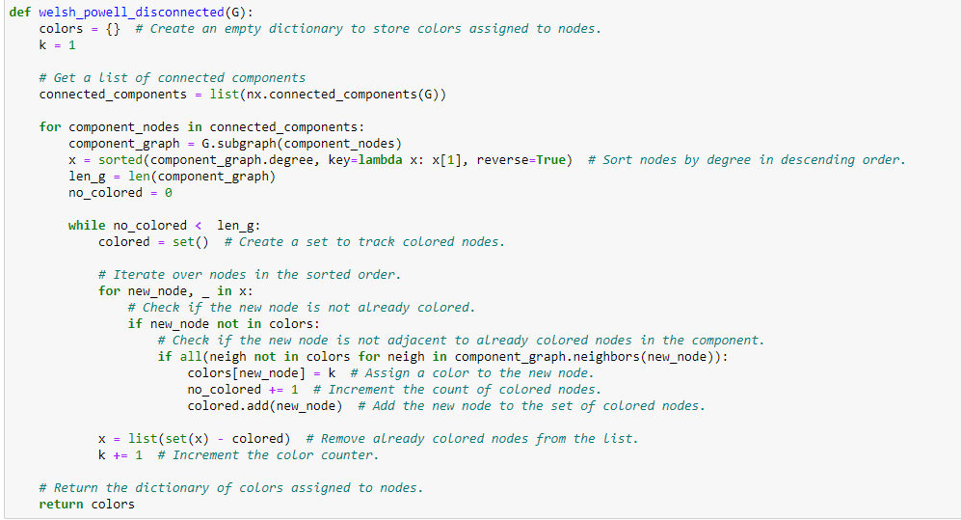
WELSH POWELL ALGORITHM FOR DISCONNECTED GRAPHS

Slide 13
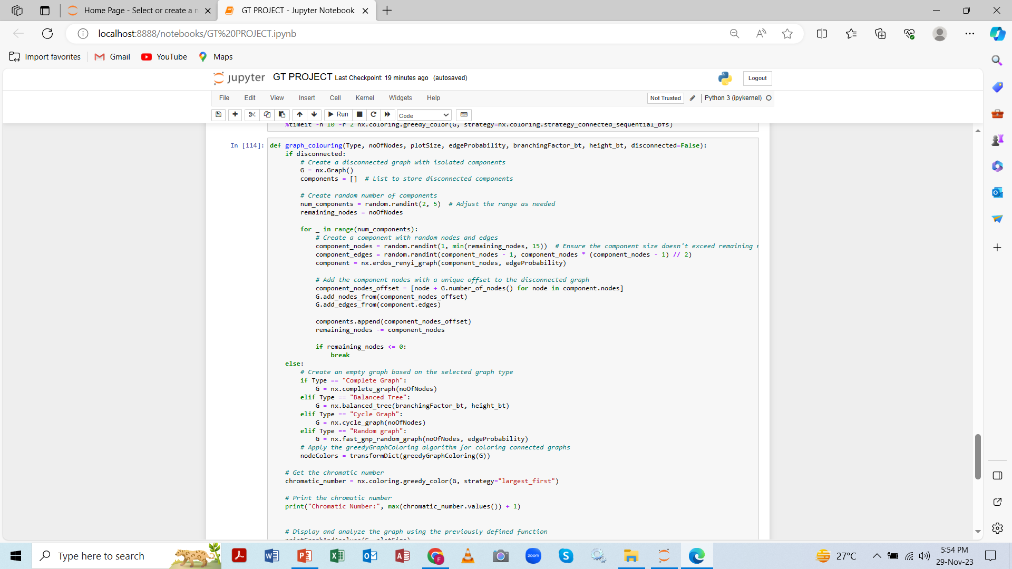
UI (GRAPH VISUALIZATION)

Slide 14
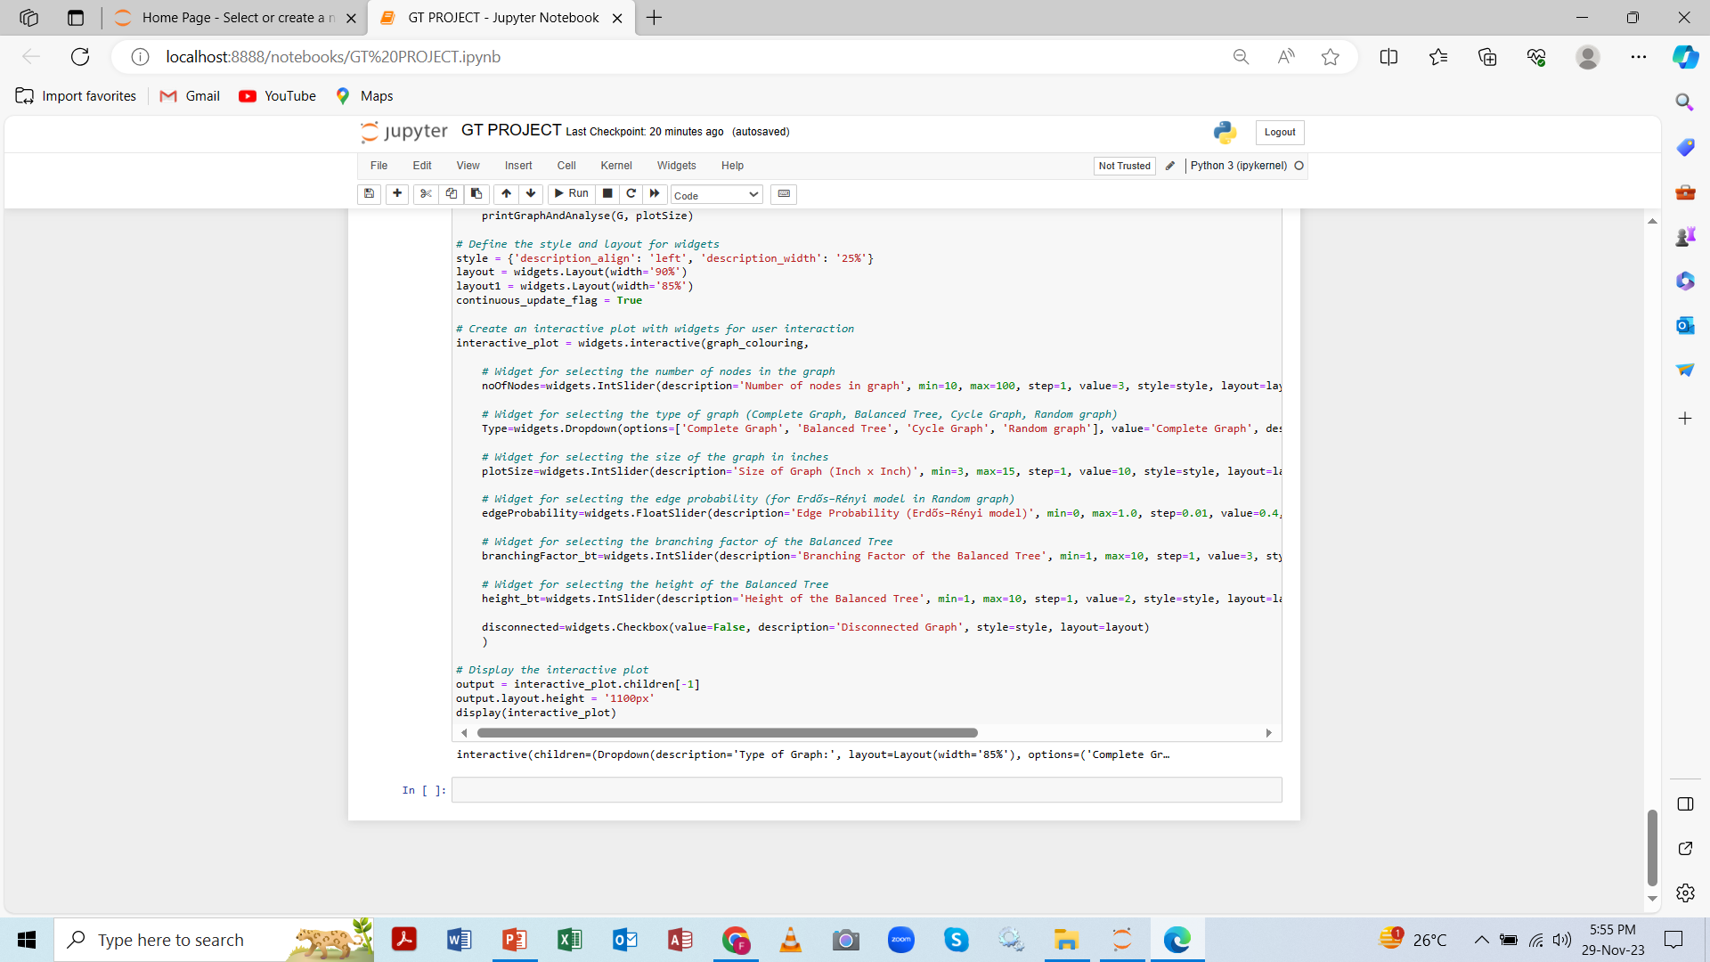
UI (WIDGETS)

Slide 15
INPUT AND RESULTS

Slide 16
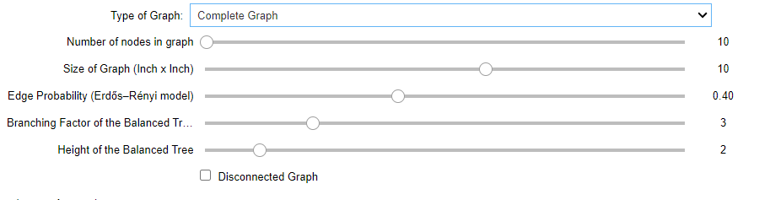
INPUT
Uses drop-down list with options for complete, cycle, balanced trees, and random graphs along with disconnected graphs.

Slide 17
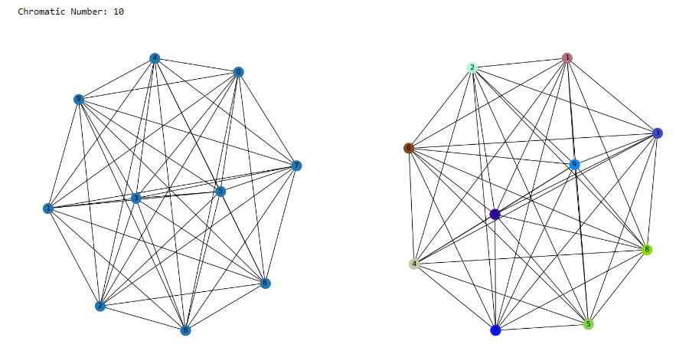
COMPLETE GRAPH

Slide 18
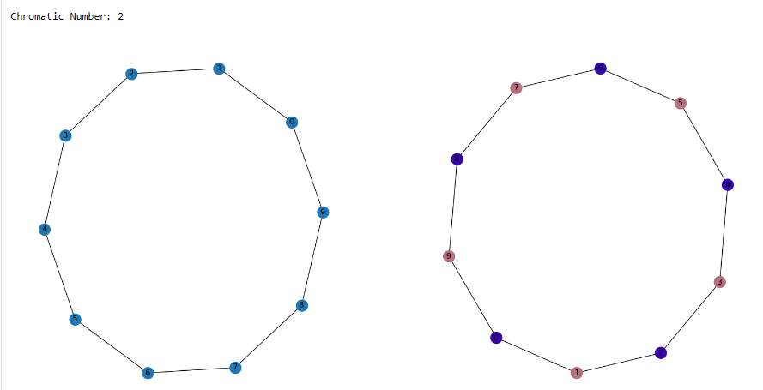
CYCLE GRAPH

Slide 19
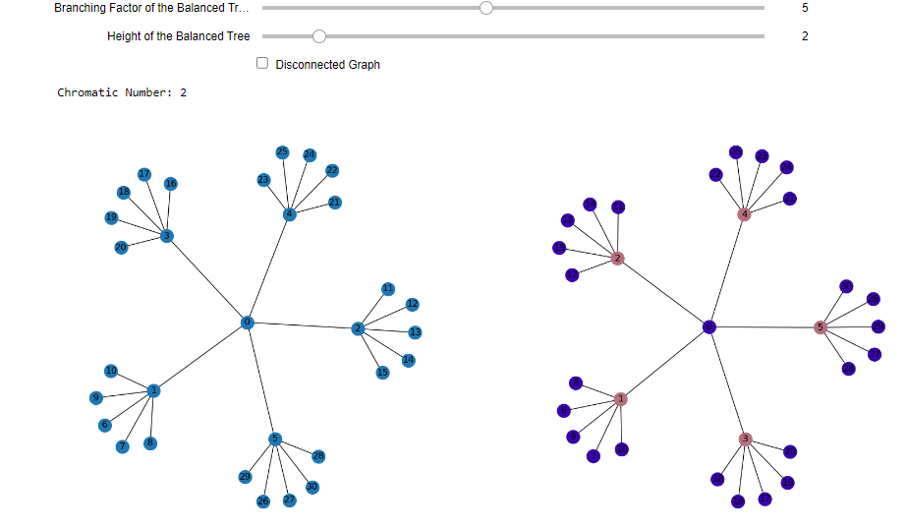
BALANCED TREES

Slide 20
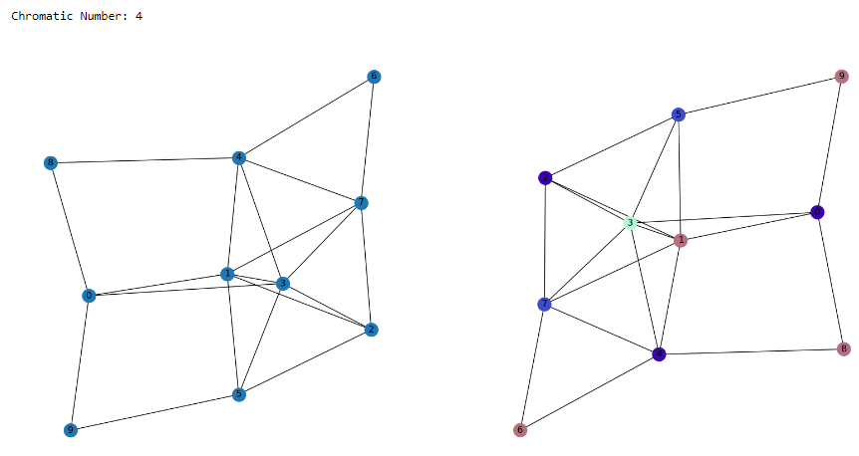
RANDOM GRAPH CONNECTED

Slide 21
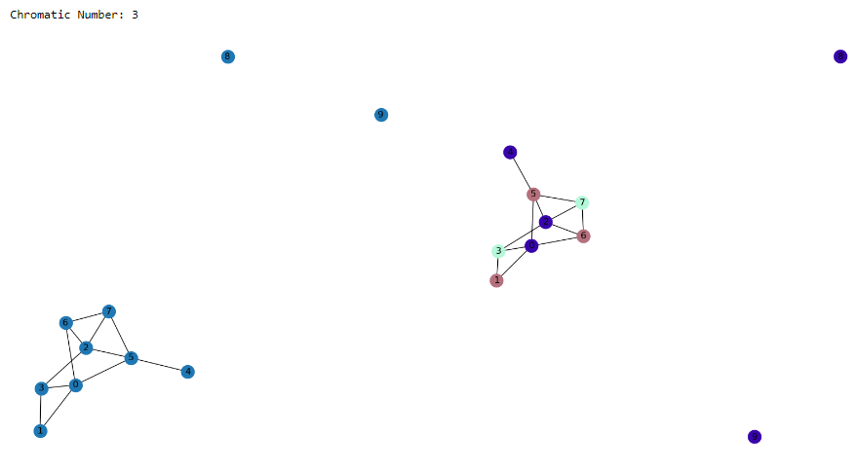
DISCONNECTED GRAPH

Slide 22
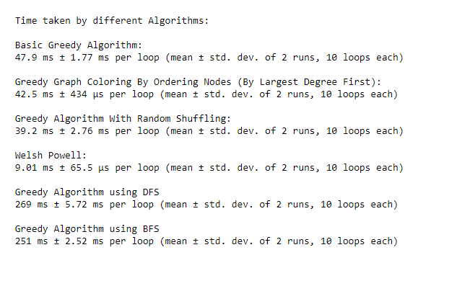
TIME ANALYSIS USING A 500 VERTICES GRAPH

Slide 23
CONCLUSION
From the above examples we can infer that:
For small number of nodes basic greedy algorithm outperforms all other algorithms.
For smaller number of nodes basic greedy performs the best because pre-processing causes overhead in other algorithms. For example sorting, etc.
For larger number of nodes Welsh Powell is the best algorithm to go with.
Generally the method of reduction of nodes used in Welsh Powell is better compared to other algorithms so it has an edge when number of nodes increases astronomically.
Algorithms using DFS/BFS always lag compared to other algorithms because time taken for traversing tree increases when compared to list/array used in other
algorithms.

Slide 24
THE END ANY QUESTIONS?

